Slide 1
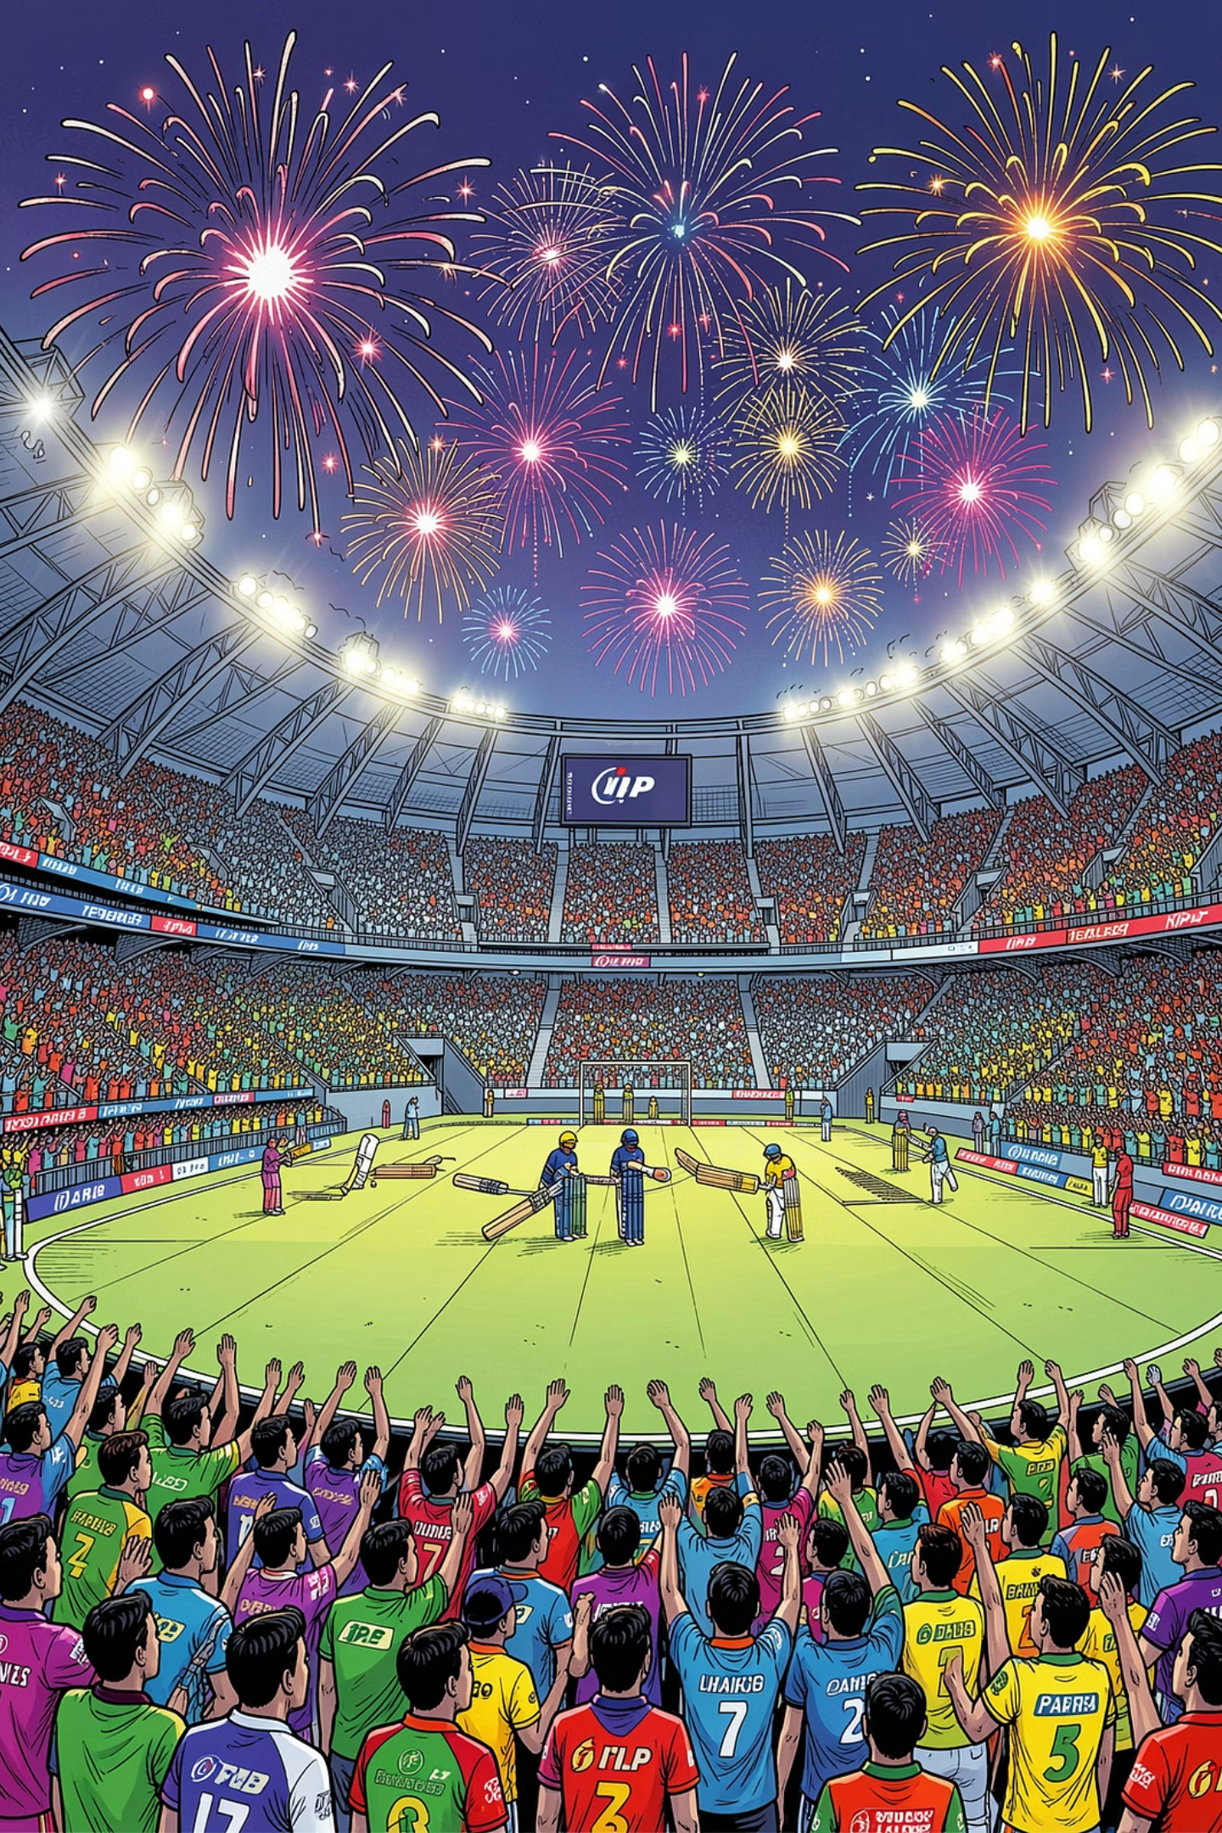
IPL Stats & Quiz Project
A fully interactive Python-powered cricket dashboard — built for fans, by fans. Enter your details, explore match data, crunch strike rates, and test your IPL knowledge in one seamless experience.
STUDENT PROJECT
PYTHON + DATA
IPL 2024

Slide 2





What This Project Does
This project brings together everything an IPL fan could want in a single interactive terminal experience. From personalized onboarding to live stats and a timed quiz, it's a complete cricket companion built in Python.
User Profile
Match Table
Top Strike Rates
Capture username, favorite team, and favorite team’s IPL overview
Full tabular view of all IPL matches with winners and MOTM
Displays the top 3 strike rates of players from the teams
SR Calculator
IPL Quiz
Custom strike rate calculator for any runs and balls combination
10-question quiz with optional start, scoring, and timing
Ja.n. Arunthamizhan

Slide 3

Step 1: User Onboarding
The project kicks off with a friendly, personalized welcome. The user is prompted to enter three key pieces of information that shape the rest of their experience.
Username
Favorite IPL Team
The user types in their name or nickname. This is used throughout the project to personalize messages, quiz results, and the final scorecard — making the experience feel truly theirs.
The user selects their favorite IPL franchise (e.g., MI, CSK, RCB). This gives them their teams overview.
Ja.n. Arunthamizhan

Slide 4

Step 2: Personalized Overview
After collecting user inputs, the program displays a clean, formatted overview summarizing everything the user entered. This acts as a welcome screen before diving into the data-heavy sections.
What Gets Displayed
Why It Matters
A personalized greeting using the username
Their chosen favorite IPL team highlighted
Their preferred match position noted
A brief welcome message about the IPL season
This overview creates a sense of personalization right from the start. Instead of jumping straight into raw data, the user feels acknowledged. It's a small UX touch that makes the project feel polished and intentional — like the program was built just for them. Not like its actually made for them.
Think of this as the "locker room intro" before the main game begins!
Ja.n. Arunthamizhan

Slide 5
Step 3: Full Match Data Table
The centerpiece of the stats section is a complete, well-formatted table displaying every IPL match from the season. This is where raw data becomes readable and useful.
Match #
Team 1
Team 2
Winner
Man of the Match
1
CSK
RCB
CSK
Ruturaj Gaikwad
2
MI
DC
MI
Rohit Sharma
3
KKR
SRH
KKR
Sunil Narine
4
RR
PBKS
RR
Sanju Samson
The table can be expanded to include additional columns like margin of victory, date, or toss winner. Using Python's tabulate library or formatted f-strings keeps the output clean and aligned in the terminal.
Ja.n. Arunthamizhan

Slide 6
Step 4: Top 3 Strike Rates
Once the user's favorite team is known, the program filters and displays the top 3 strike rates among players from that team. Strike rate is one of the most exciting batting metrics in T20 cricket — it measures how quickly a batsman scores.
185+
3
100
Elite Strike Rate
Players Shown
Baseline SR
Top finishers in T20 cricket often maintain SR above 185 — a benchmark for explosive batting
The program displays exactly the top 3 performers from the user's chosen team
A strike rate of 100 means 1 run per ball — the minimum benchmark for a healthy T20 innings
Strike Rate Formula: SR = (Runs Scored ÷ Balls Faced) × 100. Players are sorted in descending order so the most explosive batsmen appear first.
Ja.n. Arunthamizhan

Slide 7
Step 5: Custom Strike Rate Calculator
Beyond pre-loaded stats, the project includes an interactive calculator that lets users compute strike rates for any combination of runs and balls. This turns passive viewing into active exploration.
How It Works
Example Output
User is prompted to enter number of runs
User is prompted to enter number of balls
Program calculates: (runs / balls) × 100
Result is displayed with a fun contextual message
Handles edge cases like zero balls gracefully
Runs: 45
Balls: 30
Strike Rate: 150.00
🔥 That's a power-hitter's strike rate! You'd be opening in the IPL!
Users can run the calculator multiple times to compare different hypothetical performances.
Ja.n. Arunthamizhan

Slide 8




Step 6: The IPL Quiz — Optional but Fun
Before launching into the quiz, the program asks the user: "Do you want to take the IPL quiz? (y/n)" This optional gate respects the user's choice — only those who press y proceed. Any other key skips the quiz entirely.
Prompt Shown
User Presses 'y'
User Presses Anything Else
"Want to test your IPL knowledge? Press y to start, any other key to skip."
Quiz launches immediately — 10 questions appear one at a time with multiple choice options
Quiz is skipped silently. The program continues or ends gracefully — no errors, no pressure
This optional design pattern is great UX — it gives users control without breaking the flow for those who want to participate.
Ja.n. Arunthamizhan

Slide 9


Step 7: Quiz Structure & Scoring
The quiz consists of 10 carefully crafted IPL questions covering teams, players, records, and memorable moments. A timer tracks how long the user takes, adding a competitive layer to the experience.
1
2
Questions Displayed One-by-One
Answer Validation
Each question appears individually with multiple-choice options (A, B, C, D), keeping focus sharp and the interface clean.
User input is captured and compared against the correct answer. Case-insensitive handling ensures "A", "a", and "A." all work.
3
4
Score Tracking
Timer & Scorecard
A running score is maintained throughout. At the end, the user sees their total — e.g., "You scored 7/10!"
The time module records start and end timestamps. The final scorecard shows score, time taken, and a personalized message using the username.

Slide 10
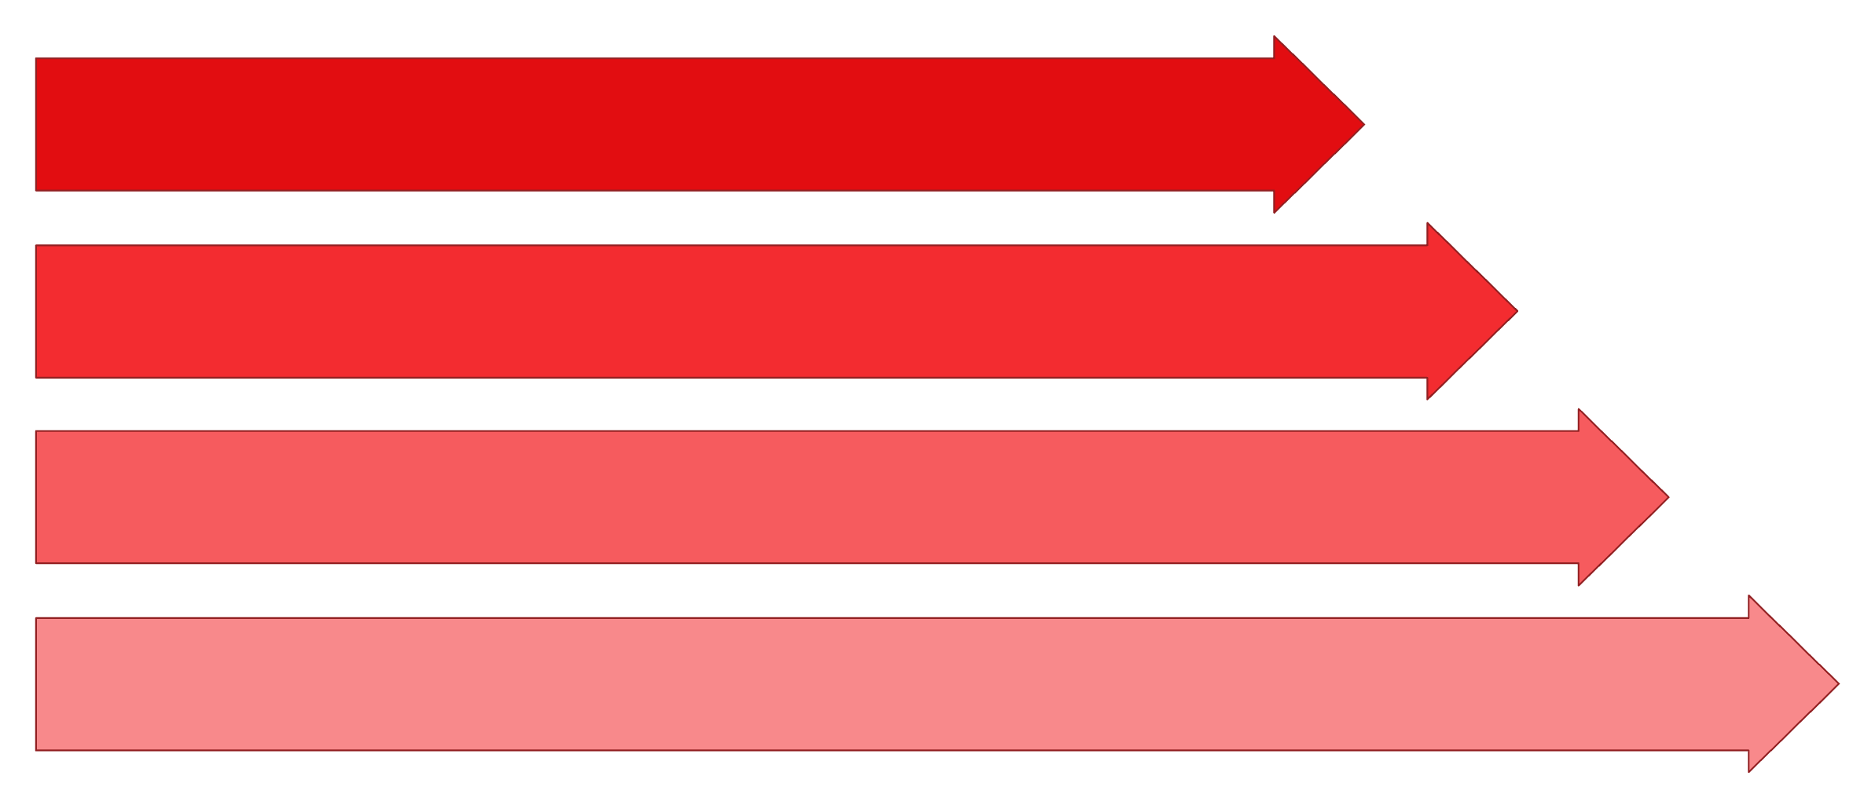
Project Summary & What You've Built
This IPL Stats & Quiz project is a complete, end-to-end interactive experience that combines data handling, user input, conditional logic, and time tracking — all in one Python program. Here's the full journey:
User Onboard
Personal Overview
Match Data
Strike Rate + Quiz
From a learning perspective, this project touches on input/output handling, data structures (lists, dictionaries, tables), conditional logic (y/n quiz gate), math operations (strike rate formula), and time module usage — making it an excellent portfolio piece for any student or hobbyist developer.
🏏 Cricket Data
⚡ Interactive
Real IPL stats, teams, and player records
User-driven inputs and personalized outputs
🧠 Educational
🏆 Complete
Covers core Python concepts in a fun context
End-to-end flow from login to final scorecard
Ja.n. Arunthamizhan

